Slide 1
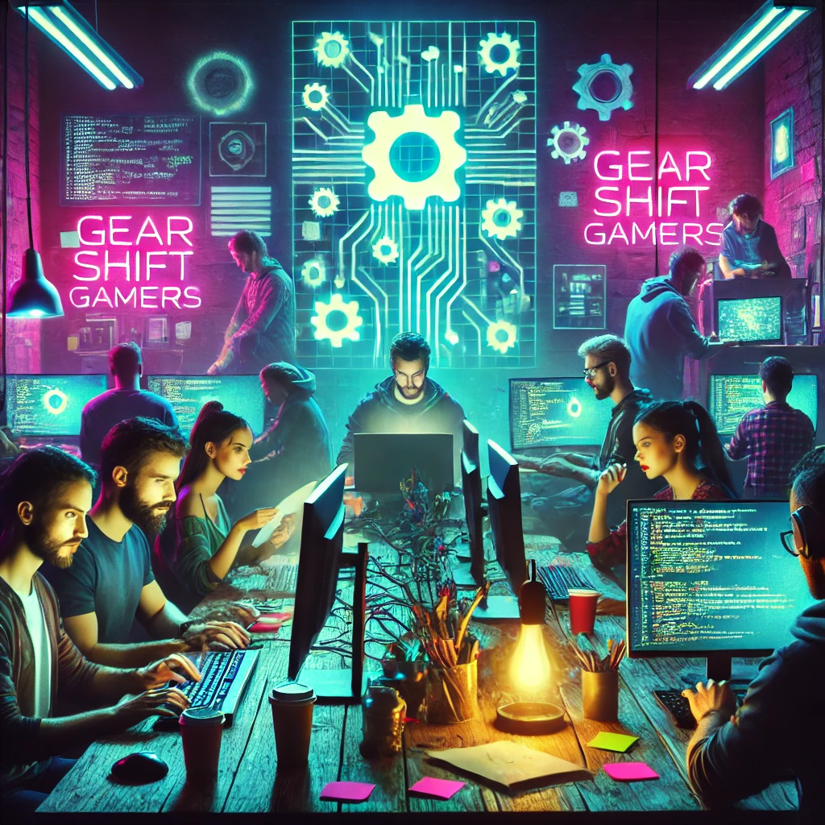
Make the SDV even more fun to use for the passengers
Challenge: Play by wire
GearShifterGamers, November 2024

Slide 2
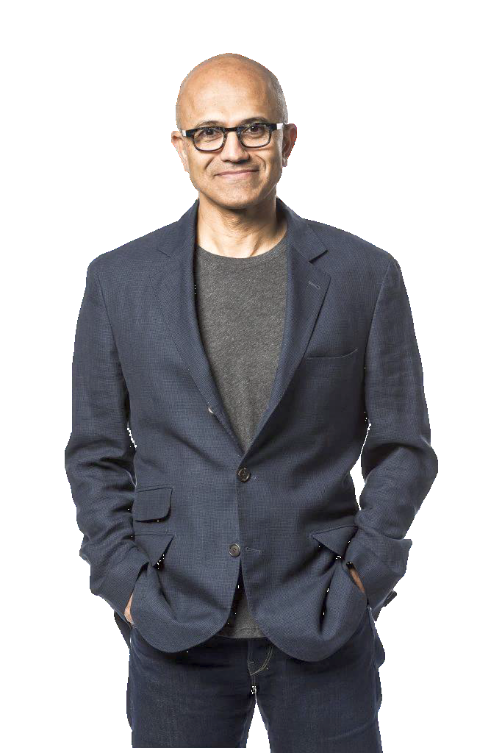
Every business will be a software business. Satya Nadella, Chairman and Chief Executive Officer of Microsoft
Notes:
„Why is it worth making the car even more fun for the passengers?“ And if it is not a software business, then it will not be a business anymore

Slide 3
Notes:
To make it even more concrete:
We see it already in very non-obvious areas -- at least for me: Example Pregnancy test
Choice at drug store:
Plain/analogue version
Digital version

Slide 4
Notes:
Let‘s have a deeper look inside of it
Light sensor
Microcontroller
LEDs
Batterie
So far so good. But why ….

Slide 5
Notes:
Exactly the same test test strip as in the analogue version?!
Why the tech stuff?
- LED makes the test result more visible
Photosensor checks whether we have 1 or two result lines
Microcontroller calculates the result
THAT‘S IT
So: Every business will be a software business

Slide 6
Source: https://www.popularmechanics.com/science/a33957256/this-programmer-figured-out-how-to-play-doom-on-a-pregnancy-test/
Notes:
People have had a deeper look in the digital version, and played around with it: similiar as we have done it this WEEK with the Eclipse-Toolboxes
Powerful Microcontroller
Bluetooth interface to connect keyboard
… and capability to play DOOM on it
If this is already possible with a pregnancy test: Why not with a car and ist HPCs?
Let‘s PLAY BY WIRE, and make business with it.

Slide 7





Business market – video games
Mobile games market
€91.57 Billion Revenue (2024)
6.39% CAGR¹ p.a.
€111.00 Billion Revenue (2027)
€53.45 ARPU² (2024)
Source: Statista
(1) Corresponding average growth rate (2) Average Revenue Per User
Notes:
STATISTA says:
Already Mobile Gaming‘s revenue is >3times higher than music business market‘s revenue
Still increasing average growth rate of >6%
Average revenue per user of >50€ / a

Slide 8


Business market – video games
Whole video games market
€261.80 Billion Revenue (2024)
8.76% CAGR¹ p.a.
€339.20 Billion Revenue (2027)
€119.50 ARPU² (2024)
Source: Statista
(1) Corresponding average growth rate (2) Average Revenue Per User
Notes:
STATISTA says:
Whole Video Games Market revenue is even 3 times the Mobile Games market (thus >9 times the music market‘s revenue)
Still increasing average growth rate of >8% in the next 3 years
Average revenue per user of ~120€ / a
Huge business opportunity for automotive industry – let‘s go into it!

Slide 9


The vision: Make the SDV fun to use for the passengers as well

Slide 10
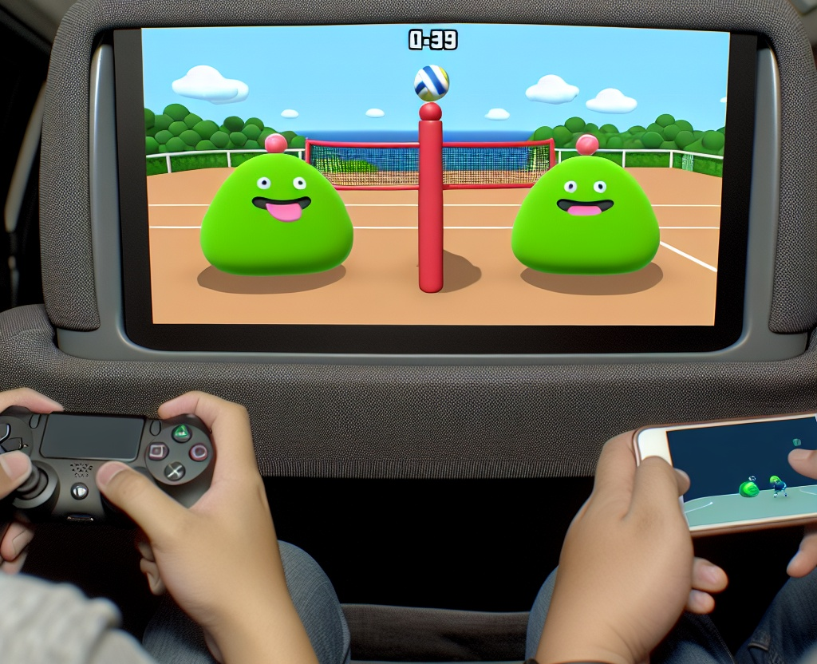
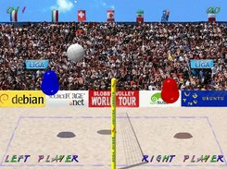
Make the SDV fun to use for the passengers as well

Slide 11

Make the SDV fun to use for the passengers as well
Adaptable: Deploy whatever ARM-based multiplayer game on its hardware (Game Store)
Notes:
Game Store: canonical business opportunity here

Slide 12


Make the SDV fun to use for the passengers as well
Adaptable: Deploy whatever ARM-based multiplayer game on its’ hardware (Game Store)
Variable: Connect different controlling interfaces (usual game controller, any mobile device)

Slide 13

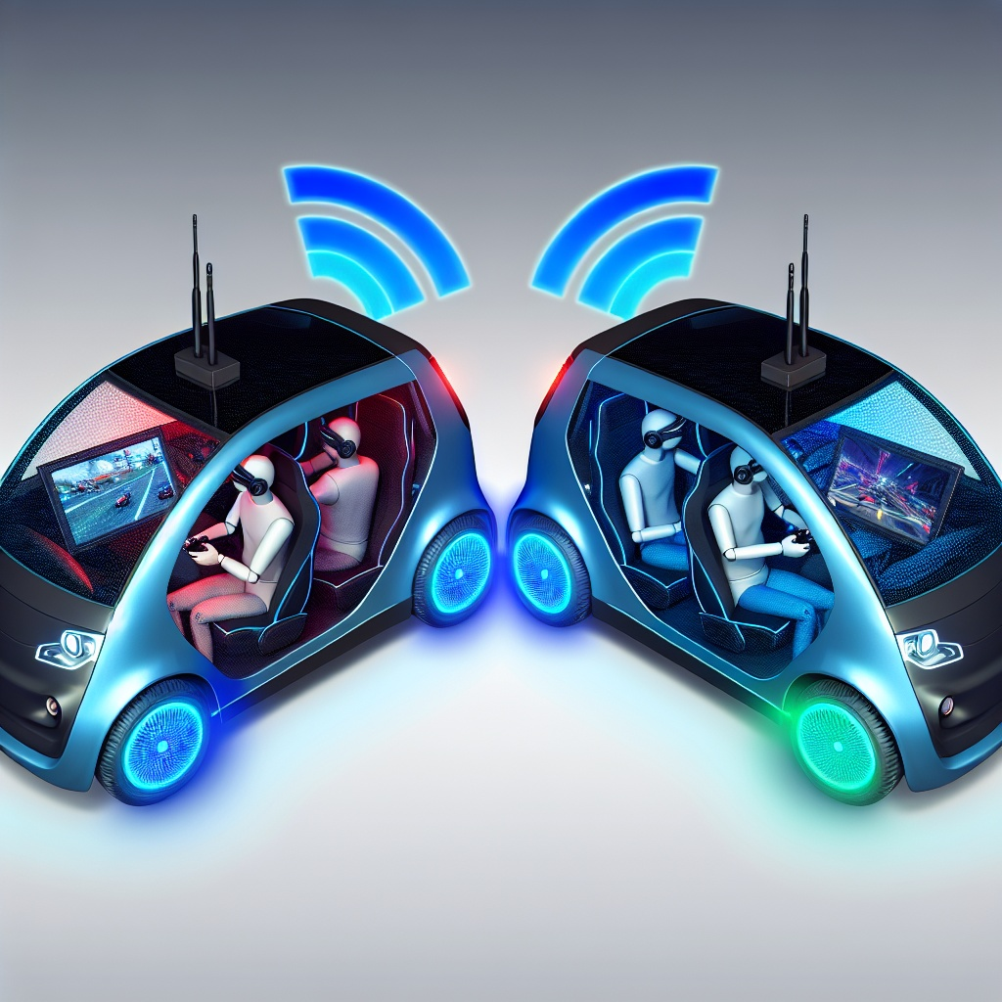
Make the SDV fun to use for the passengers as well
Adaptable: Deploy whatever ARM-based multiplayer game on its’ hardware (Game Store)
Variable: Connect different controlling interfaces (game controller, mobile device)
Extendable: Connect >1 car and have Software-Defined-Car-Parties
Notes:
Let the driver participate: make stats visible with Ankaios Dashboard in HMI / Headup-Display
?? 5G Cloud Gaming

Slide 14

Tech Stack | Architecture

Slide 15
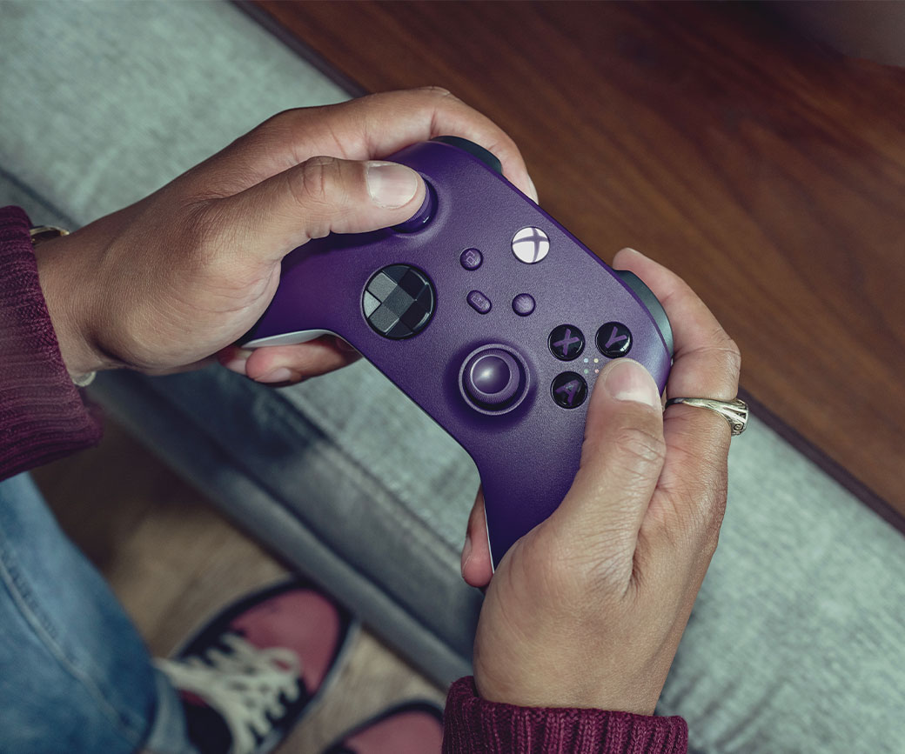
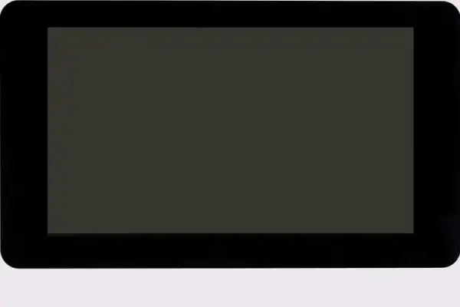
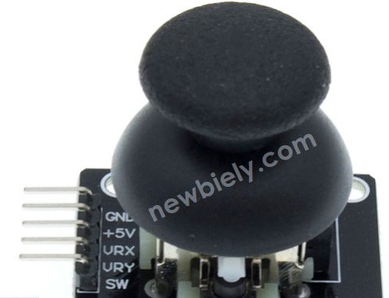
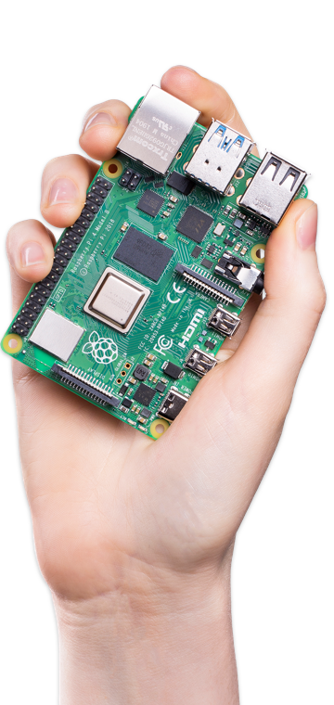
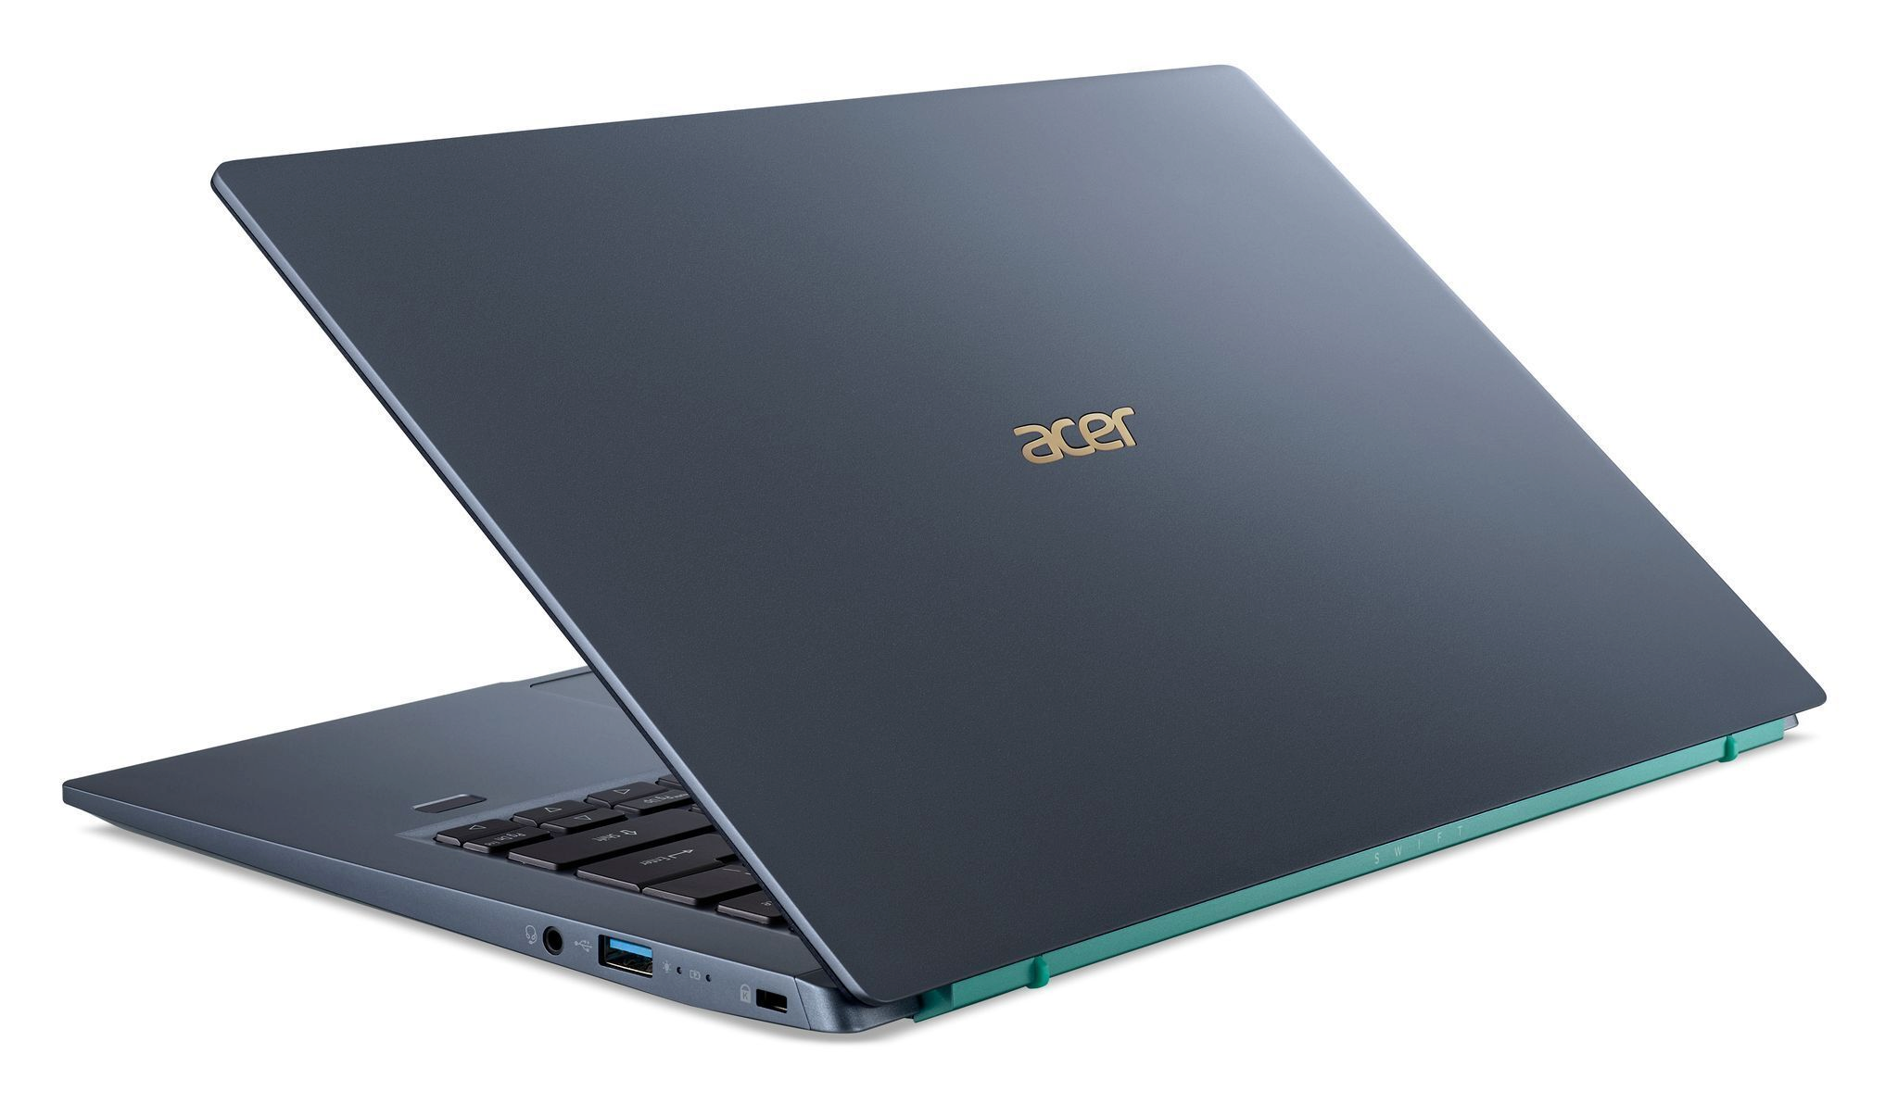
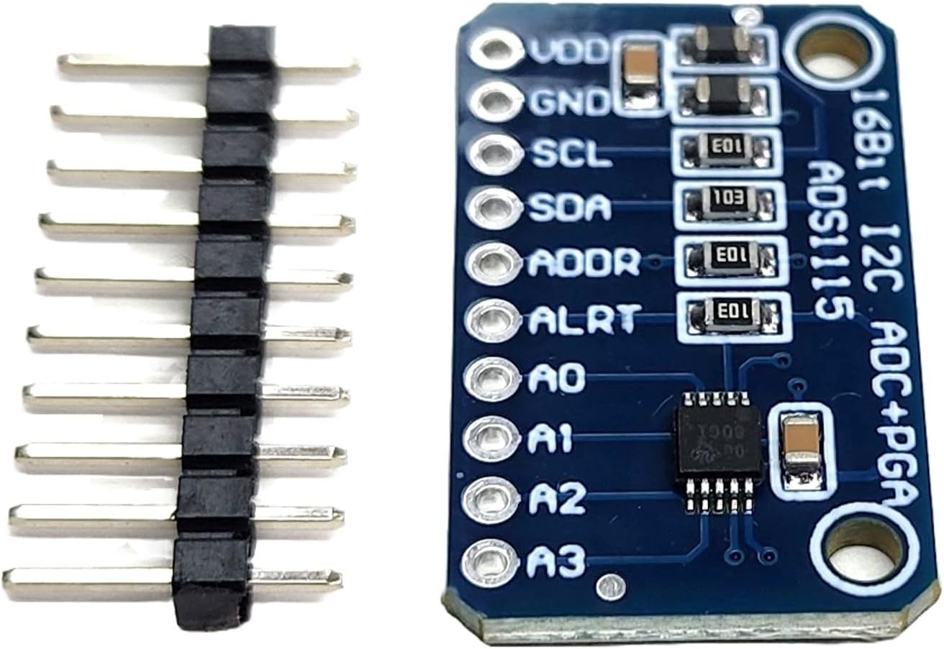


Incredients
Hardware
https://www.raspberrypi.com/products/r aspberry-pi-touch-display/
https://newbiely.com/tutorials/ raspberry-pi/raspberry-pi-joystick
Source: https://www.xbox.com/de-DE/accessories/ controllers/xbox-wireless-controller#blue
https://images.idgesg.net/images/article/2021/02/
acer-swift-3x-angle-100878455-orig.jpg
https://www.amazon.de/dp/B0D8BF6KRF
https://www.raspberrypi.com/products/raspberry-pi-4-model-b/
Eclipse Projects / Utilities
Video Game
Leight weight:
Open Source Code:
Multiplayer:
Only few control input:
6.3MB
C++
2-player

Slide 16
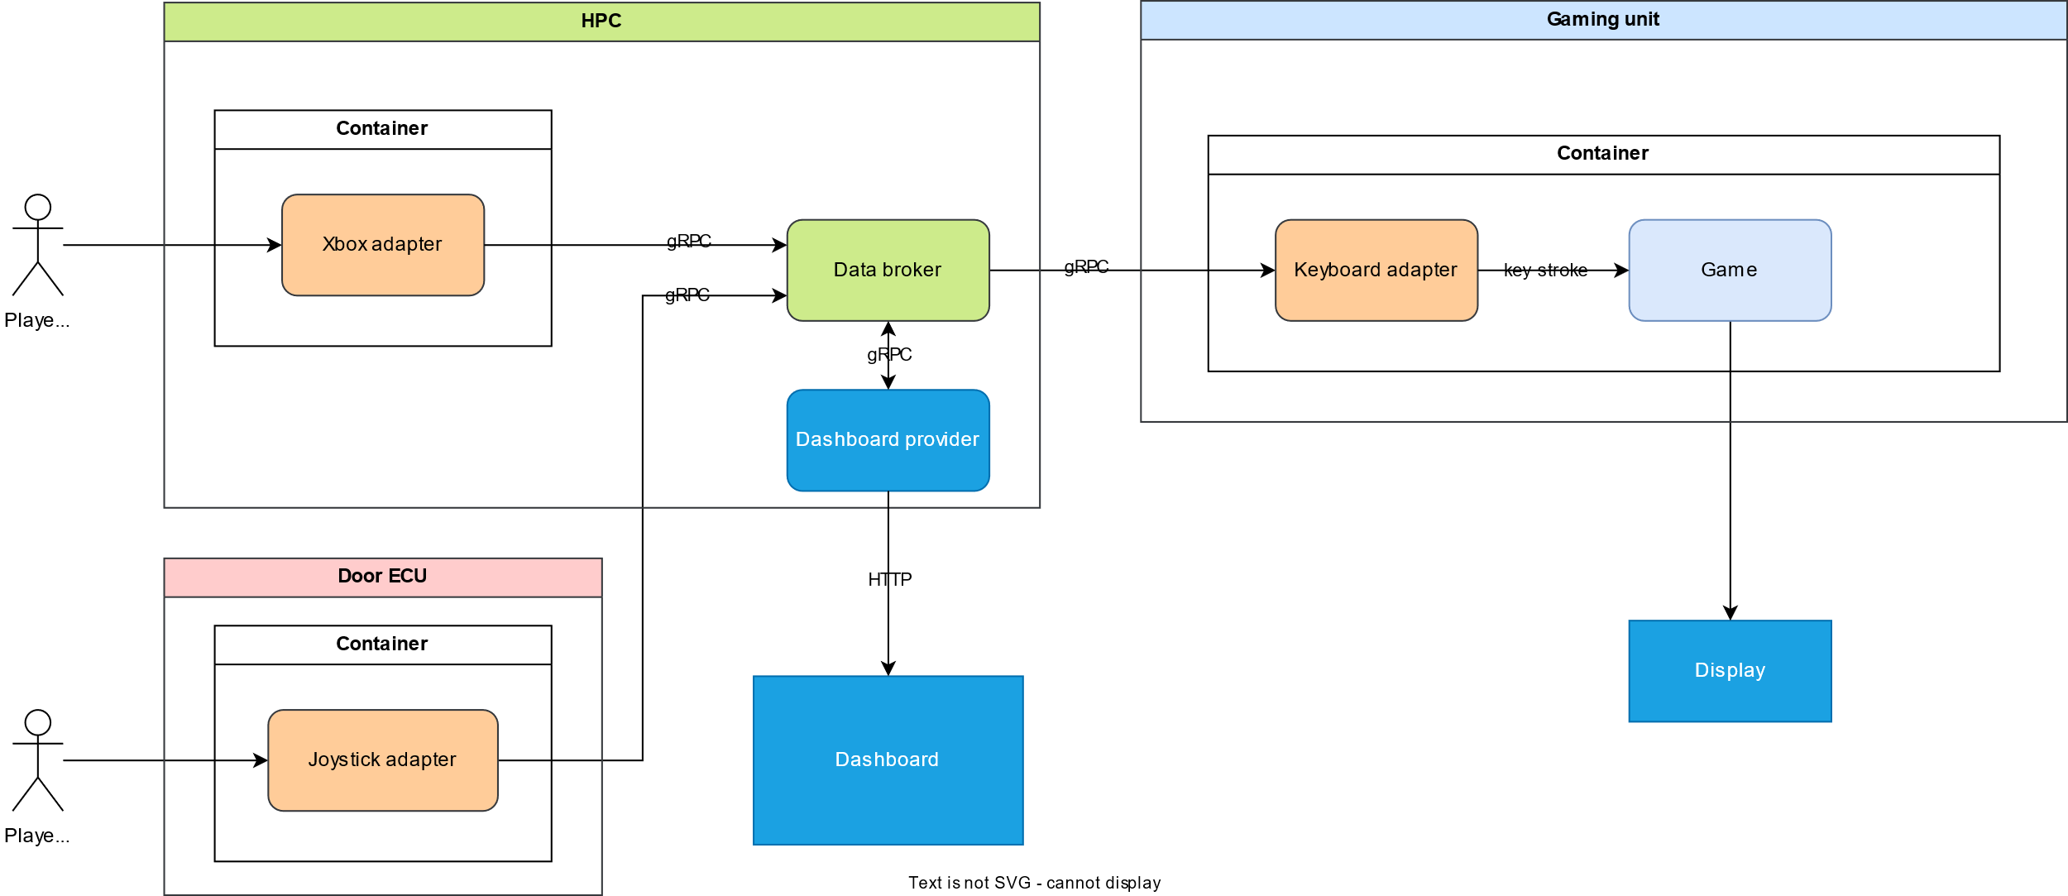
Solution architecture
Generic controller
Car component

Slide 17

Demo time!

Slide 18

Hier steht eine kurze Überschrift
Notes:
Outlook: Make Doom available not only on pregnancy test stripes
Even more serious: Go into the dawning Cloud gaming market.

Slide 19
Thank you very much! Any questions?

Slide 20
Contact
Dr. Sebastian Probst
IAV GmbH
Rockwellstraße 12, 38518 GIFHORN (GERMANY) Phone +49 173 5710 138
sebastian.probst@iav.de
www.iav.com

Slide 21
Control Information
Project: |  | GearShiftGamers
Version: |  | 1.0
Status: |  | draft / released / not valid
Confidentiality: |  | public / internal / confidential / strictly confidential
 | Date | Name |  | Dept. | Phone
Created: | 21.11.2024 | Dr. Sebastian Probst |  | TT-A6 | +49 173 5710 138
Reviewed:
Released: | 21.11.2024 | Pavel Spakowski
Change History
Version | Date | Name | Changes

